Slide 1

Time SMART “SURAKSHA” : THE SHIELD OF STRENGTH
R
E
L
A

Slide 2
Problem
Vulnerability of Children
Delayed Response Times
Inadequate Emergency Alert Systems
Children are particularly at risk, as existing safety measures do not adequately monitor their whereabouts or alert guardians when they are in danger or out of designated safe zones.
Without real-time location tracking, assistance often arrives too late, as victims struggle to communicate their whereabouts during emergencies.
Many existing personal safety devices lack efficient methods for rapidly alerting family members or authorities during emergencies, leaving victims isolated in critical situations.
Limited Self-Defense Options
Lack of Awareness Among Bystanders
Psychological Impact
Individuals frequently lack effective self-defense tools or mechanisms, leaving them vulnerable in threatening scenarios without the means to protect themselves..
Without audible alarms or alerts, potential witnesses may remain unaware of emergencies occurring nearby, preventing timely intervention.
The fear of personal safety threats can lead to increased anxiety and stress among individuals, hindering their sense of security in everyday life.

Slide 3
Solution
Proactive Personal Safety
Provides an integrated safety system to ensure individuals can quickly alert others during emergencies.
Voice-Activated Emergency Response
Allows users to activate the system hands-free using a simple voice command, ensuring immediate assistance without requiring physical action.
Real-Time Location Tracking
Continuously monitors and transmits the user's location, enabling quick identification and rescue during critical situations.
Child Safety Monitoring
Notifies guardians if a child is outside a designated safe zone for too long, enhancing parental awareness and ensuring children's safety
IMMEDIATE ALERT MECHANISM
Activates loud alarms to draw attention from nearby individuals, increasing the likelihood of a rapid response from bystanders

Slide 4
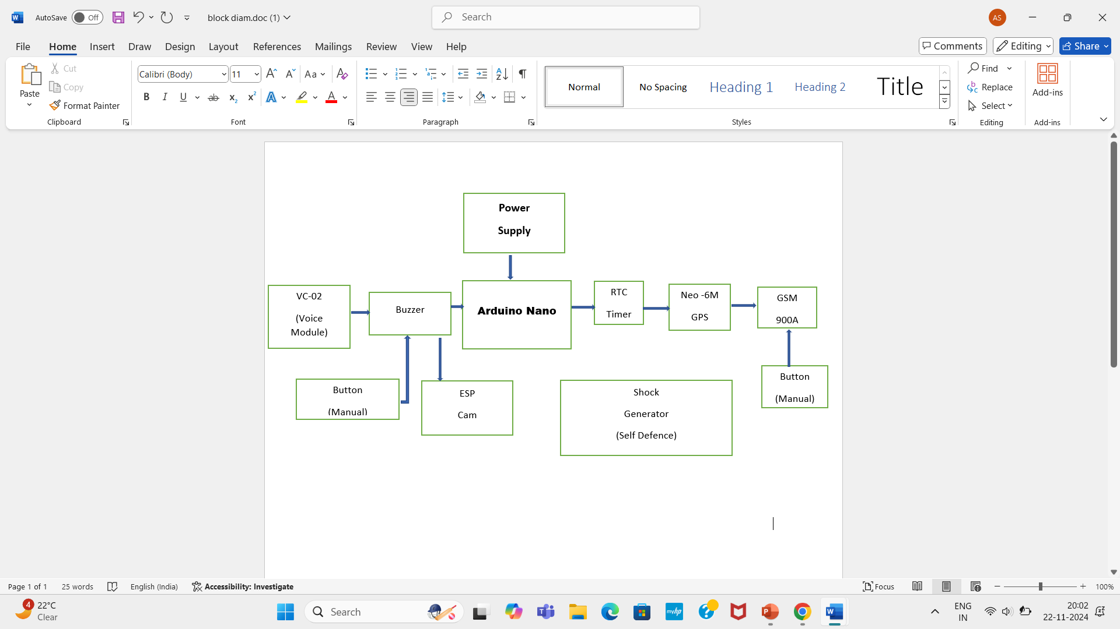
BLOCK DIAGRAM

Slide 5
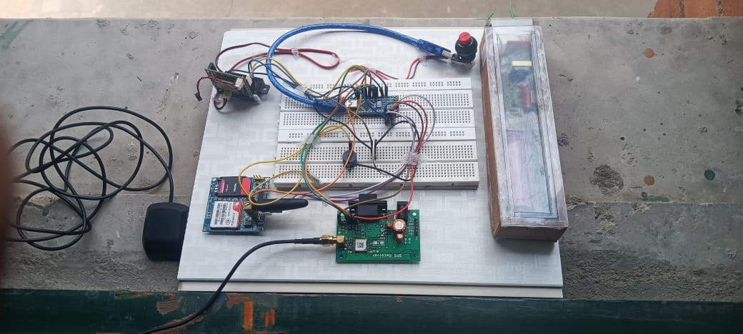
Circuit Diagram

Slide 6
Tech stack
VC-02 Voice Recognition Module
Shock Generator
Button
Buzzer
NEO-6M GPS Module
GSM 900 A module
Arduino Nano
Google Maps API
Power Supply Units
Real Time Clock
ESP CAM

Slide 7

Methodology
The "Real-Time Smart SURAKSHA: The Shield of Strength" project is an innovative safety device for children, integrating advanced technologies for real-time monitoring and protection. It utilizes the VC-02 voice recognition module, NEO-6M GPS, GSM 900A module, RTC timers, buzzer, ESP32-CAM, and an Arduino Nano, along with a shock generator for self-defense.
This system offers personalized safety features for women, men, and children:
For Adults (Men and Women): Provides a voice command feature, shock generator for self-defense, live streaming, and GPS-based location sharing for emergency situations.
For Children under 10 years old: Tracks time spent away from home, triggers alerts if they are out for too long, and offers live streaming via the ESP32-CAM for situational awareness and real-time location monitoring.
For Children above 10 years old: Includes a manual alert button, live streaming, and GPS-based location sharing for emergency situations.
This device ensures timely alerts, location tracking, and personal safety, tailored to the needs of different users.

Slide 8
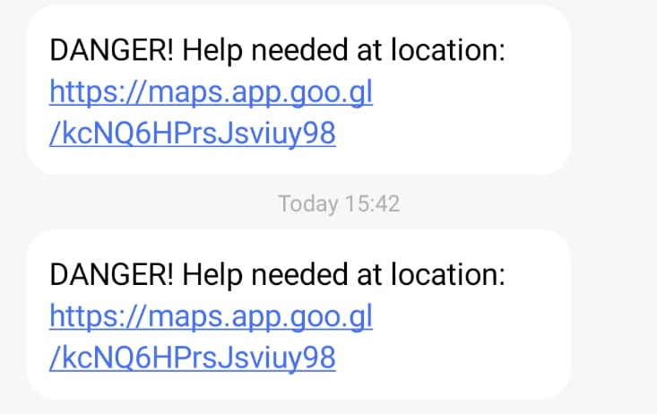
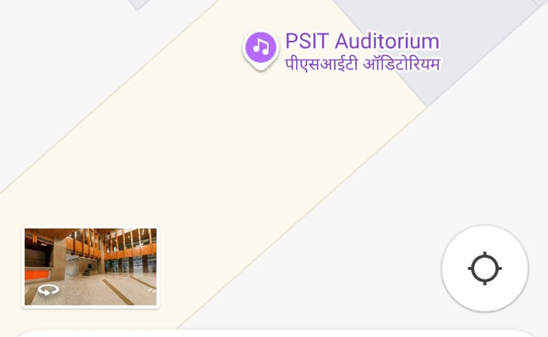
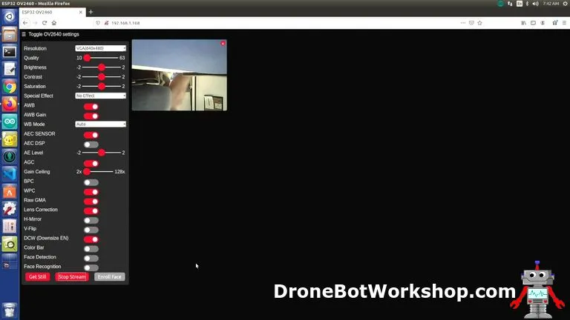
Working prototype
Model
Alarming system
Location sharing
LIVE STREAMING
SURAKSHA
Alert is sent to the Guardian
Current Location of the victim is shared
Captures the images/live streaming

Slide 9

USE CASE- 01
for Children (Under 10 Years Old)
Scenario: A child is out playing with friends but has exceeded the usual time outside.
Features Involved:
RTC Timer: Triggers an alert if the child stays outside longer than the predefined time.
Live Streaming via ESP32-CAM: Streams the surrounding environment for situational awareness.
GPS Location Sharing and buzzer activation: Sends real-time location data to the parent’s phone and activates the buzzer.
Buzzer Alert: Activated if the timer exceeds the threshold, warning the child or nearby people of potential danger.
Expected Outcome: Parents receive the child's location along with live streaming to ensure safety. If the child is in danger or lost, the buzzer and location sharing provide immediate assistance.

Slide 10
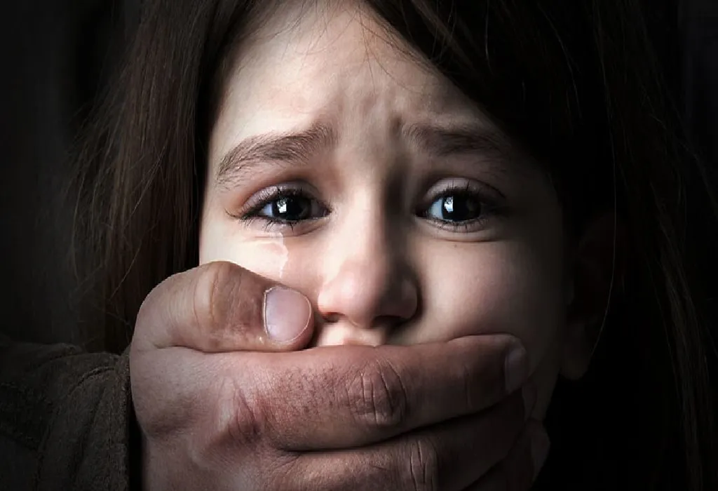
Use case - 02
for Children (Above 10 Years Old)
Scenario: A child goes out for a walk but encounters a potential threat.
Features Involved:
Manual Alert Button: The child presses the button to activate the buzzer and to send an immediate alert to the parents, notifying them of potential danger.
GPS Location Sharing: Sends the child’s current location to the parents, providing real-time tracking.
Live Streaming via ESP32-CAM: Streams the child’s environment to help the guardian assess the situation.
Expected Outcome: The child’s location is shared instantly, and the parents can view the live stream. They can make informed decisions, such as contacting authorities or rushing to the location.

Slide 11
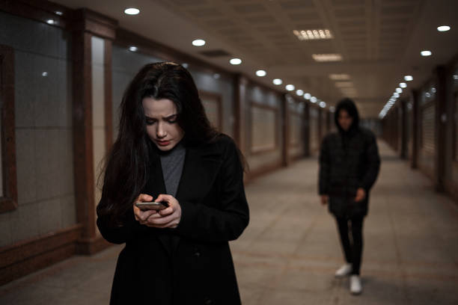
USE CASE -03
For Women
Scenario: A woman walking home late at night feels unsafe due to a suspicious individual following her.
Features Involved:
Voice Command: She activates the system via voice commands to trigger an emergency (buzzer)response .
Shock Generator for Self-Defense: If necessary, the system activates the shock generator to deter the attacker.
Live Streaming via ESP32-CAM: Streams the situation to a trusted contact or emergency services.
GPS Location Sharing: Sends her location to a pre-set phone number or guardian.
Expected Outcome: The woman is able to protect herself using the shock generator, while her location is shared with trusted contacts, and the situation is live-streamed for real-time monitoring.

Slide 12
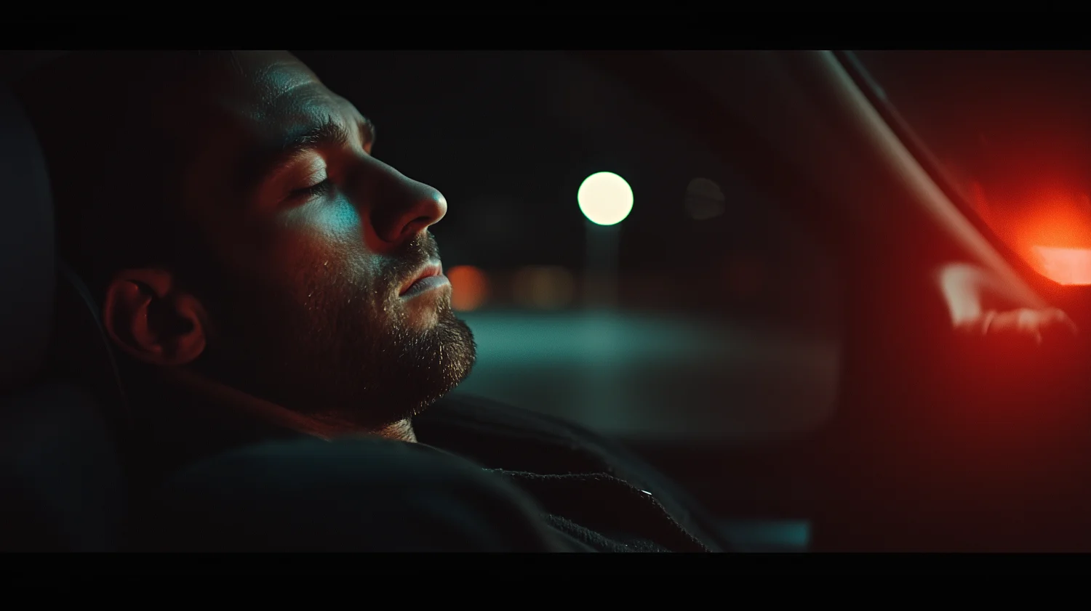
Use case -04
for Men
Scenario: A man is traveling in an unfamiliar area and feels threatened by individuals approaching him.
Features Involved:
Voice Command: He activates the device using a voice command to notify his contacts or activate emergency functions.
Shock Generator for Self-Defense: The shock generator is triggered as a deterrent in case of physical confrontation.
Live Streaming via ESP32-CAM: Streams the environment to a trusted contact or family member.
GPS Location Sharing: Shares the current location to ensure the man’s whereabouts are known by trusted contacts.
Expected Outcome: The man receives real-time monitoring and protection, with his location shared for immediate help. The shock generator serves as a defensive tool, and the live stream ensures his safety.

Slide 13
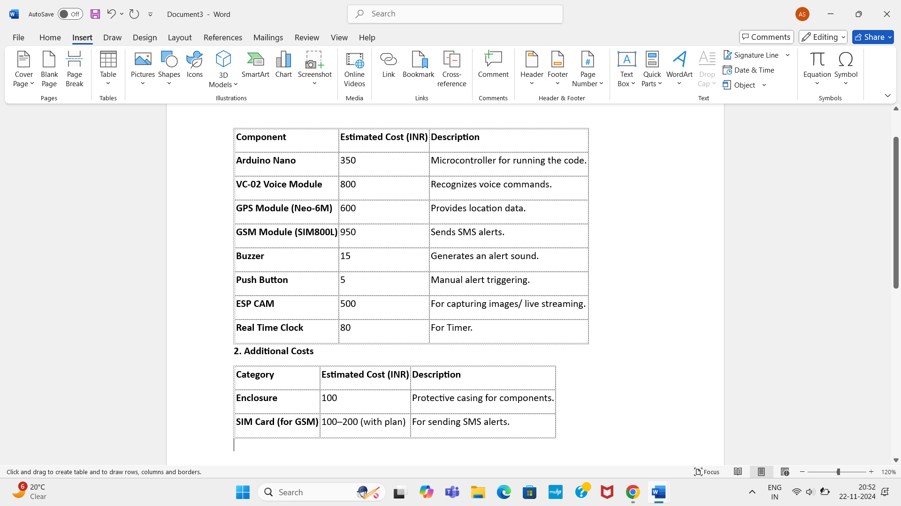
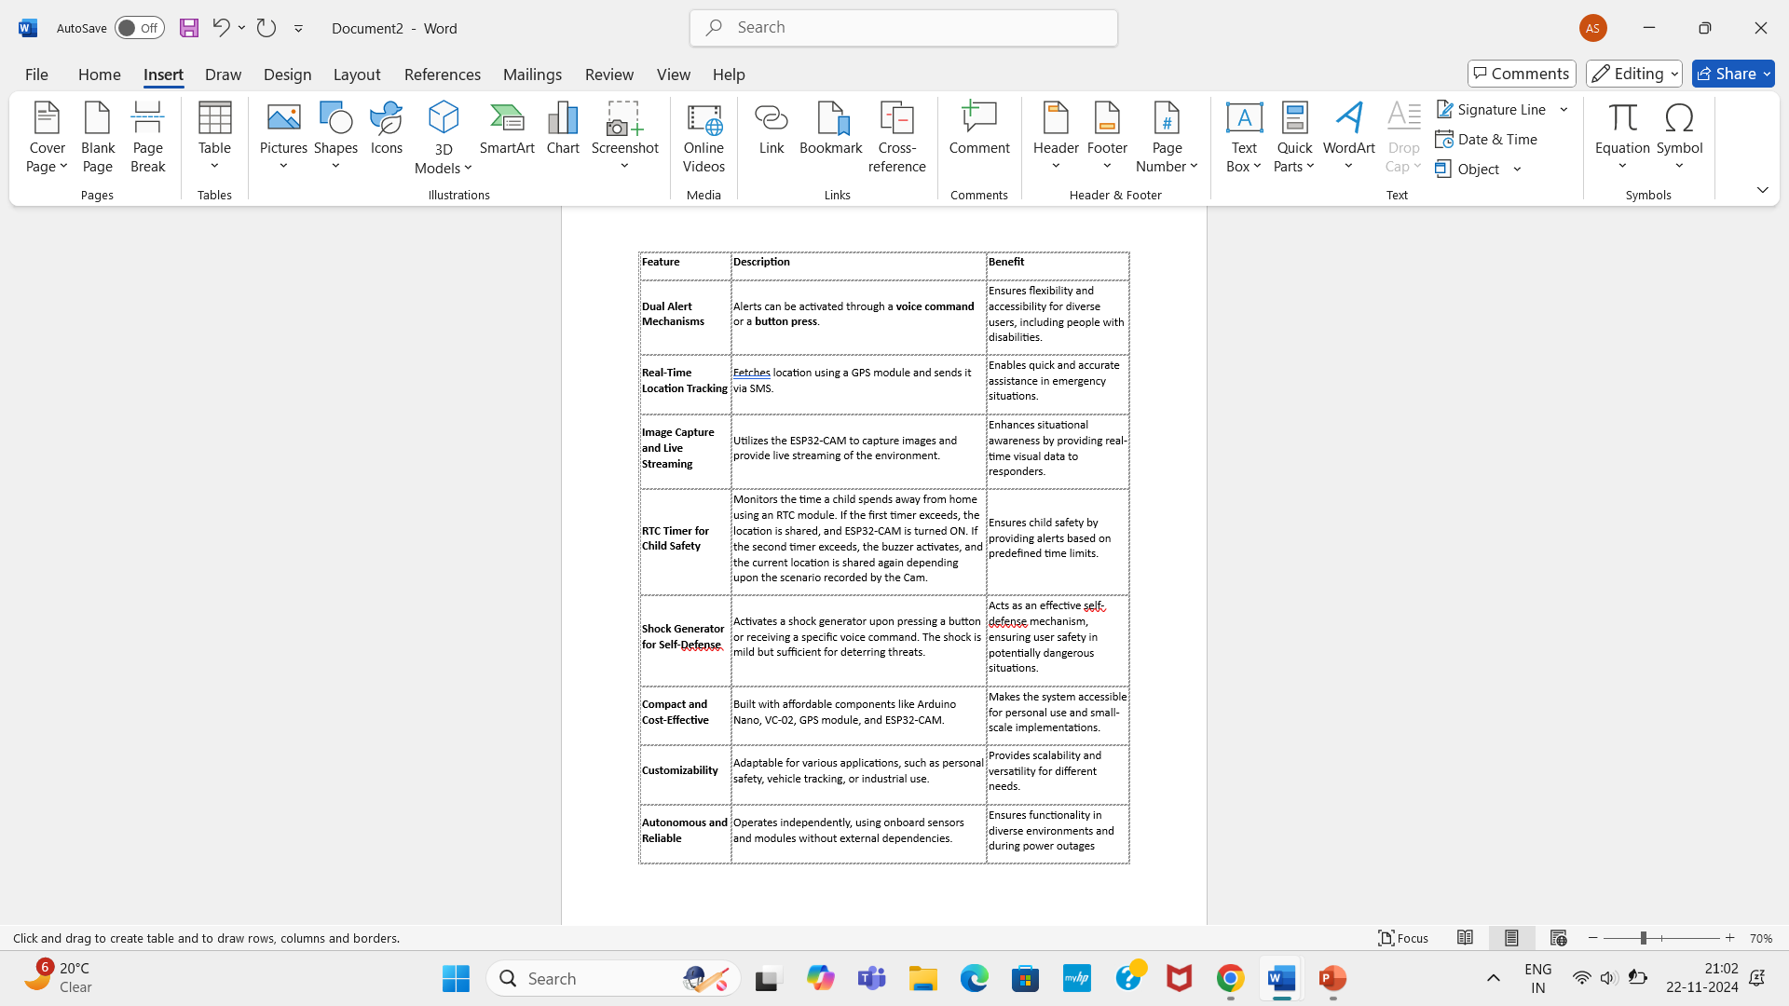
Cost Analysis and USP
COST ANALYSIS
Unique Selling Proposition

Slide 14
future SCope
Machine Learning Enhancements
Utilize machine learning algorithms to differentiate between false alarms and genuine emergencies, improving accuracy.
Geofencing Capabilities
Implement geofencing to set virtual safety boundaries, sending alerts when children cross them.
Multi-Language Support
Incorporate multi-language capabilities in the voice recognition module to cater to a diverse user base.

Slide 15

conclusion
In conclusion, our project offers a comprehensive safety solution by integrating cutting-edge technologies such as voice recognition, GPS tracking, live streaming, and self-defense mechanisms. Designed for children, women, and men, it provides personalized protection through features like real-time location sharing, situational awareness via live streaming, and emergency alerts via manual buttons or voice commands. The system also includes unique functions such as a shock generator for self-defense, RTC timers for monitoring duration away from home, and the ability to handle emergency situations effectively. This multi-functional device ensures that users, regardless of age or gender, are protected and empowered with immediate safety measures, contributing to greater peace of mind in potentially dangerous situations.

Slide 16


Thank you
Arpita Shukla
Ajeet Singh
Muskan Kushwaha
Prashasti Tripathi

